Slide 1



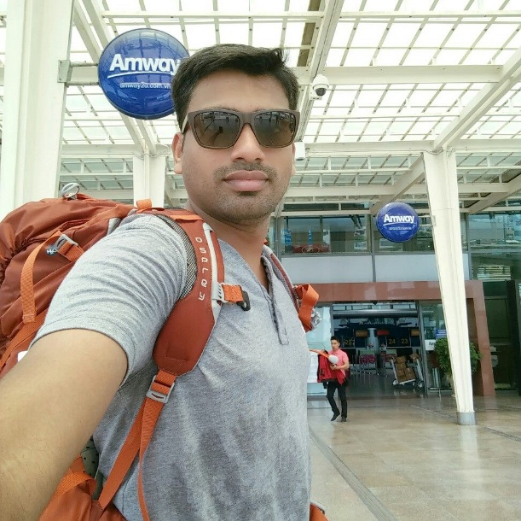






RIVERVALE ROCKETS CRICKET CLUB RIVERVALE ROCKETS CRICKET CLUB RIVERVALE ROCKETS CRICKET CLUB RIVERVALE ROCKETS CRICKET CLUB RIVERVALE ROCKETS CRICKET CLUB RIVERVALE ROCKETS CRICKET CLUB RIVERVALE ROCKETS CRICKET CLUB RIVERVALE ROCKETS CRICKET CLUB
SCORE
CUP
OVERS
30
3
BALLS
MAIDEN
35
1
FOUR’S
RUNS
0
4
SIXES’S
Rocket Singh of the Match
WICKETS
2
KAMLESH MALVIYA
3
Alpha vs Mustangs
16-Jul-2023
RIVERVALE ROCKETS CRICKET CLUB RIVERVALE ROCKETS CRICKET CLUB RIVERVALE ROCKETS CRICKET CLUB RIVERVALE ROCKETS CRICKET CLUB RIVERVALE ROCKETS CRICKET CLUB RIVERVALE ROCKETS CRICKET CLUB RIVERVALE ROCKETS CRICKET CLUB RIVERVALE ROCKETS CRICKET CLUB

